Slide 1


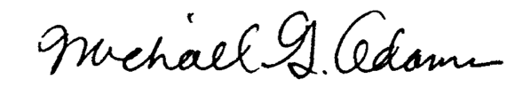
Kentucky Scholarship
Granting Organizations
Overview for the Prichard Committee
Presented by the Kentucky Secretary of State
Office of Business Services
October 2, 2026

Slide 2


Federal Framework
26 U.S.C. § 25F establishes a federal credit beginning in 2027.
➢ Federal law and Treasury/IRS guidance govern eligibility.
➢ Beginning in 2027, individual taxpayers may claim a nonrefundable federal credit of up to $1,700 for qualifying cash contributions to listed SGOs; under the proposed rules, married couples filing jointly may claim up to $3,400 based on each spouse’s contributions.
➢ Eligible students generally must have prior-year household income not exceeding 300% of area median gross income, adjusted for family size.
➢ SGOs must satisfy § 25F requirements, including the 90% scholarship-spending rule, scholarships for at least 10 students who do not all attend the same school, separate accounting for qualified contributions, and eligible-use requirements.
➢ Eligible scholarship expenses include a broad range of K–12 educational expenses permitted under 26 U.S.C. § 530(b)(3)(A).
Sources: 26 U.S.C. § 25F; Treasury/IRS regulations and fact sheet issued Oct. 1, 2026; proposed 30 KAR 1:060.
Kentucky Secretary of State • Office of Business Services
Scholarship Granting Organizations

Slide 3
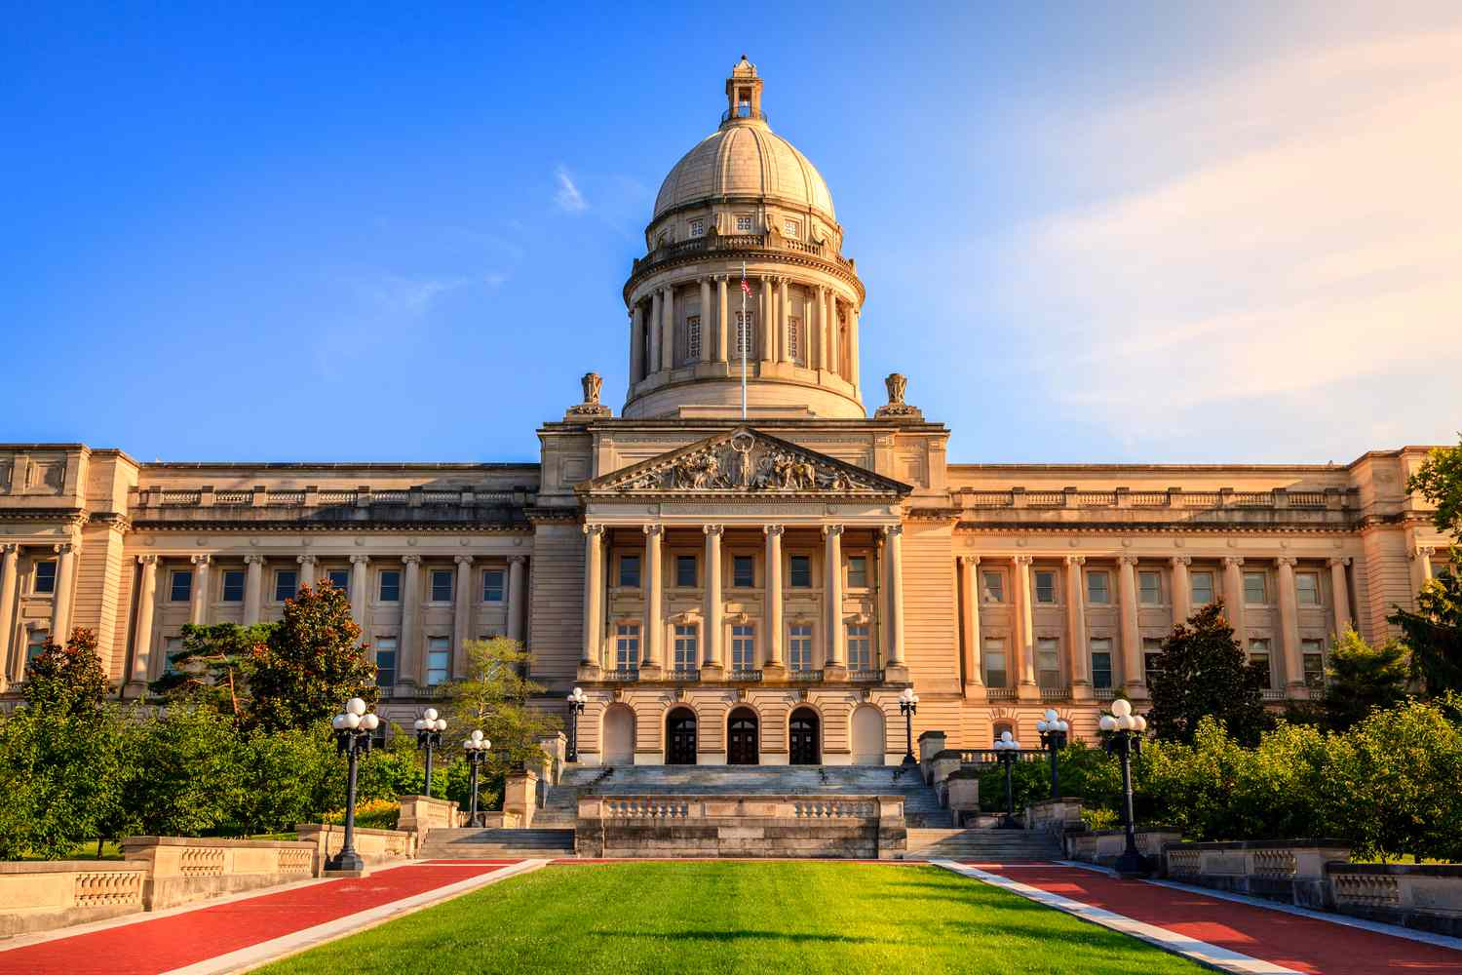

Kentucky Opts In Through HB 1
Kentucky elected to participate and assigned the state-list function to the Secretary of State.
➢ HB 1 authorizes Kentucky’s participation in the federal § 25F program.
➢ The legislation assigns the Secretary of State the administrative role of compiling SGOs and submitting Kentucky’s annual SGO list to the IRS.
➢ HB 1 became effective July 15, 2026.
➢ Kentucky filed its Advance Election Form with the IRS on July 22, 2026.
➢ The process for inclusion on Kentucky’s annual SGO list is established in proposed 30 KAR 1:060.
Sources: HB 1 (2026); Kentucky Advance Election Form filed with IRS July 22, 2026.
Kentucky Secretary of State • Office of Business Services
Scholarship Granting Organizations

Slide 4
Three Distinct Roles
Keeping these roles separate will help avoid confusion.
IRS / TREASURY
SECRETARY OF STATE
SGOs
Listed SGOs may receive qualified contributions beginning in 2027, award scholarships, maintain required accounts, and obtain their own legal, tax, fundraising, and compliance advice.
Federal eligibility, tax-credit rules, forms, and guidance under § 25F. Treasury and IRS issued proposed and temporary regulations on October 1, 2026.
Receives Kentucky filings, administers the filing process, and submits Kentucky’s 2027 SGO list to the IRS by January 1, 2027.
The SOS can explain the Kentucky filing pathway; it cannot substitute for the IRS, Treasury, or private counsel.
Kentucky Secretary of State • Office of Business Services
Scholarship Granting Organizations

Slide 5
Update: New Federal Guidance Issued October 1
Treasury and IRS released proposed and temporary regulations for the 2027 launch.
➢ Temporary regulations establish immediate procedures for state SGO submissions, separate SGO registration directly with IRS, assignment of donor numbers, acknowledgements, and reporting of qualified contributions.
➢ Proposed regulations address substantive requirements including student eligibility, SGO operations, segregated-account and safe-harbor rules, audits, and program administration.
➢The proposed regulations do not provide specific additional guidance on eligible educational expenses beyond the statutory cross-reference to 26 U.S.C. § 530(b)(3)(A).
➢ Prepare early. Form or identify an eligible nonprofit, obtain an IRS § 501(c)(3) determination letter, and file the SGO Declaration with SOS by November 30 under the proposed Kentucky regulation.
➢ Treasury states that taxpayers, states, and SGOs may rely on the proposed regulations for qualified contributions beginning January 1, 2027.
New federal certification requirements are under review.
Source: Treasury/IRS temporary and proposed regulations; Treasury-Department of Education FSTC FAQ (Oct.1, 2026).
Kentucky Secretary of State • Office of Business Services
Scholarship Granting Organizations

Slide 6
The Secretary of State’s Role—and Its Limits
The SGO filing process is primarily ministerial, not an independent federal tax compliance determination.
What our office can clarify
Questions governed by federal law or private decisions
➢ Declaration form and filing process
➢ State deadline and filing fee
➢ Annual audit filing requirement
➢ How Kentucky’s SGO list is submitted to IRS
➢ Federal tax-exempt eligibility, scholarship and expense eligibility, and household income verification (AMI)
➢ Donor, school, or family tax advice
➢ Fundraising, organizational, or program strategy
Source: proposed 30 KAR 1:060, Section 2(5); proposed federal regulations under 26 U.S.C. § 25F.
Kentucky Secretary of State • Office of Business Services
Scholarship Granting Organizations

Slide 7
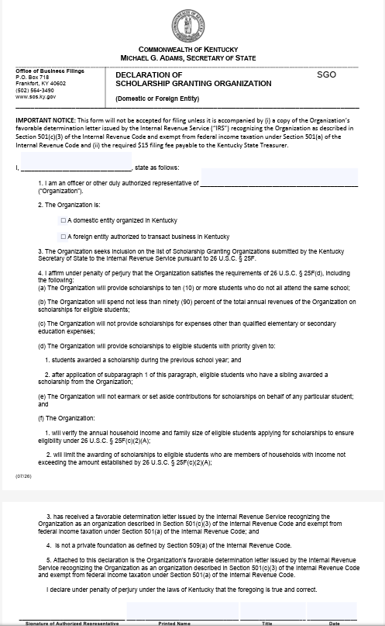
Initial Declaration Filing
For inclusion on Kentucky’s annual SGO list.
➢ File the Declaration of Scholarship Granting Organization using the exact legal name of the nonprofit entity with the Secretary of State affirming § 25F compliance.
➢ Attach a favorable IRS determination letter recognizing § 501(c)(3) status.
➢ Pay the $15 declaration filing fee.
➢ Proposed 30 KAR 1:060 uses November 30 as Kentucky’s annual declaration deadline.
Declaration requires IRS determination letter and $15 fee.
Source: proposed 30 KAR 1:060, Section 2.
Kentucky Secretary of State • Office of Business Services
Scholarship Granting Organizations

Slide 8

Annual CPA Audit Filing
Applies beginning in the calendar year after inclusion on the IRS list.
After First Year
➢ Annual independent audit prepared by a licensed certified public accountant.
➢ Filed with the Secretary of State no later than November 30.
➢ Audit filing is accompanied by a separate $15 filing fee.
Independent CPA audit filed after the first year on the IRS list.
Source: proposed 30 KAR 1:060, Section 3.
Kentucky Secretary of State • Office of Business Services
Scholarship Granting Organizations

Slide 9

What the Audit Verifies
The CPA audit is the annual compliance checkpoint.
➢ Scholarships awarded to at least ten eligible students who did not all attend the same school.
➢ At least 90% of income used for scholarships during the year.
➢ Scholarship funds used only for eligible expenses under 26 U.S.C. § 530(b)(3)(A).
➢ Household-income verification, statutory priority rules, prohibition on earmarking, separate-account requirements, and continued § 501(c)(3) qualification.
The audit verifies the SGO’s compliance with federal law; it does not make the school a direct recipient of the federal credit.
Source: proposed 30 KAR 1:060, Section 3(3).
Kentucky Secretary of State • Office of Business Services
Scholarship Granting Organizations

Slide 10
What Stakeholders Can Do Now
➢ Review the new federal guidance. Treasury and IRS issued proposed and temporary regulations on October 1, 2026.
➢ Determine whether your organization is prepared to participate. Legal structure, governance, fundraising, scholarship administration, and compliance are critical.
➢ Prepare early. Form or identify an eligible nonprofit, obtain an IRS § 501(c)(3) determination letter, and file the SGO Declaration with SOS by November 30 under the proposed Kentucky regulation.
➢ Build federal compliance into program design, including student eligibility, qualified expenses, accounting, acknowledgements, reporting, and audit requirements.
➢ Identify potential roles. Organizations may participate directly as SGOs, provide operating or philanthropic support, connect eligible families and schools with participating SGOs, or help disseminate accurate program information.
Kentucky has the opportunity—but stakeholders must organize, fundraise, and follow through.
Kentucky Secretary of State • Office of Business Services
Scholarship Granting Organizations

Slide 11
Thank You!
Please feel free to contact us directly with additional questions, concerns, or suggestions.
Michael Wilson – Executive Director of Business Services
Deputy General Counsel
mwilson@sos.ky.gov
(502) 782-7422
Kentucky Secretary of State
Office of Business Services
Kentucky Secretary of State • Office of Business Services
Scholarship Granting Organizations

